Slide 1

AWS SAM (Serverless Application Model)
Naznin Shafeek
245240

Slide 2
INTRODUCTION
The AWS Serverless Application Model (AWS SAM) is a toolkit that improves the developer experience of building and running serverless applications on AWS.
AWS SAM consists of two primary parts:
AWS SAM template specification – An open-source framework that you can use to define your serverless application infrastructure on AWS.
2.AWS SAM command line interface (AWS SAM CLI) – A command line tool that you can use with AWS SAM templates and supported third-party integrations to build and run your serverless applications.

Slide 3
AWS SAM template specification
Built on AWS CloudFormation – Use the AWS CloudFormation syntax directly within your AWS SAM template, taking advantage of its extensive support of resource and property configurations.
An extension of AWS CloudFormation – AWS SAM offers its own unique syntax that focuses specifically on speeding up serverless development.
An abstract, short-hand syntax – Using the AWS SAM syntax, you can define your infrastructure quickly, in fewer lines of code, and with a lower chance of errors.
Transformational – AWS SAM does the complex work of transforming your template into the code necessary to provision your infrastructure through AWS CloudFormation.

Slide 4
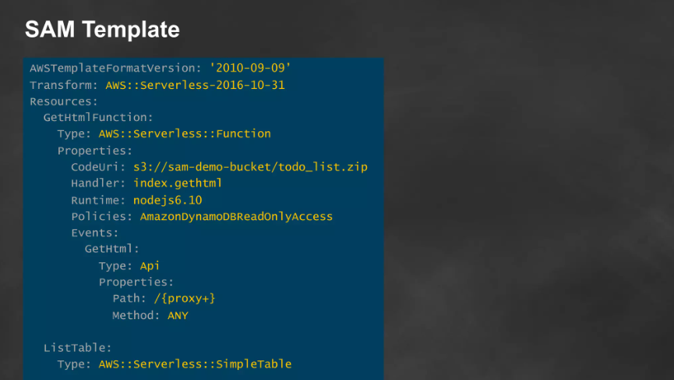
AWS SAM TEMPLATE

Slide 5
AWS SAM CLI
Use the AWS SAM CLI to:
Quickly initialize a new application project.
Build your application for deployment.
Perform local debugging and testing.
Deploy your application.
Configure CI/CD deployment pipelines.
Monitor and troubleshoot your application in the cloud.
Sync local changes to the cloud as you develop.

Slide 6
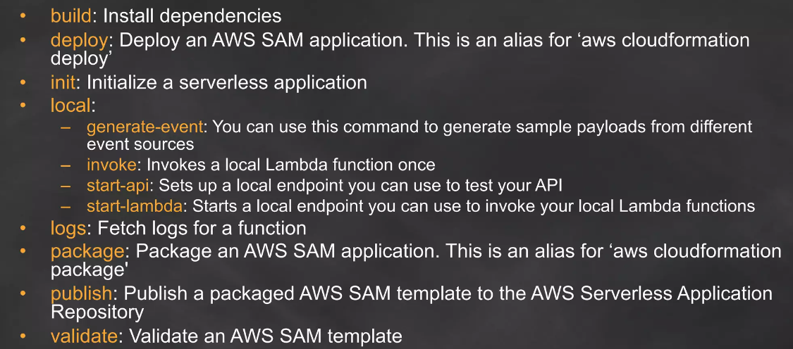
AWS SAM CLI Commands

Slide 7
AWS SAM prerequisites
Step 1: Sign up for an AWS account
Step 2: Create an IAM user account
Step 3: Create an access key ID and secret access key
Step 4: Install the AWS CLI
Step 5: Use the AWS CLI to configure AWS credentials

Slide 8
Example of a basic serverless application
This application processes requests to get all items from a database through an HTTP request. It consists of the following parts:
A function that contains the logic to process the request.
An HTTP API to serve as communication between the client (requestor) and the application.
A database to store items.
Permissions for the application to run securely.

Slide 9
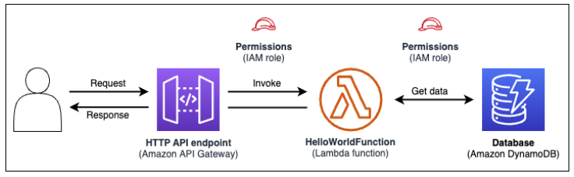

Slide 10
Benefits of using AWS SAM
Define your application infrastructure code quickly, using less code-Deploy your templates directly to AWS CloudFormation to provision your resources.
Manage your serverless applications through their entire development lifecycle-Use the AWS SAM CLI to manage your serverless application through the authoring, building, deploying, testing, and monitoring phases of your development lifecycle.
Quickly provision permissions between resources with AWS SAM connectors-AWS SAM transforms your code into the IAM permissions required to facilitate your intent.
Continuously sync local changes to the cloud as you develop-Use the AWS SAM CLI sam sync command to automatically sync local changes to the cloud, speeding up your development and cloud testing workflows.
Manage your Terraform serverless applications-Perform local debugging and testing of your Lambda functions and layers.

